Slide 1
SCRIPTER: SHOW A PHOTO DEPENDS ON THE MODEL SELECTED IN S12b

Slide 2

104. DAIHATSU ROCKY

Slide 3
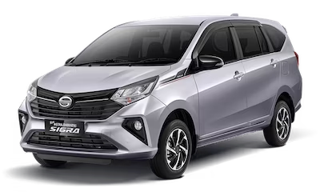
105.DAIHATSU SIGRA

Slide 4
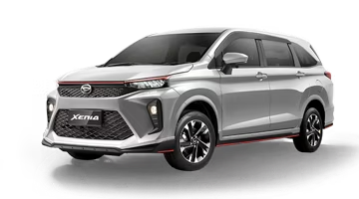
108. DAIHATSU XENIA

Slide 5
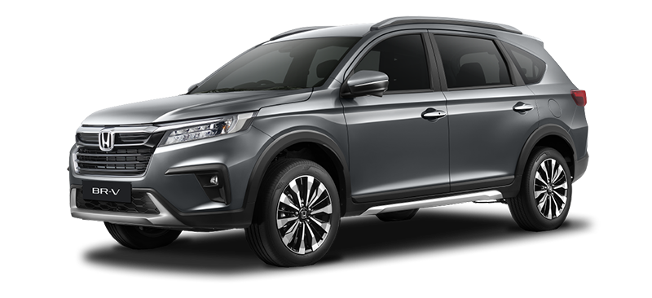
204. HONDA BR-V

Slide 6
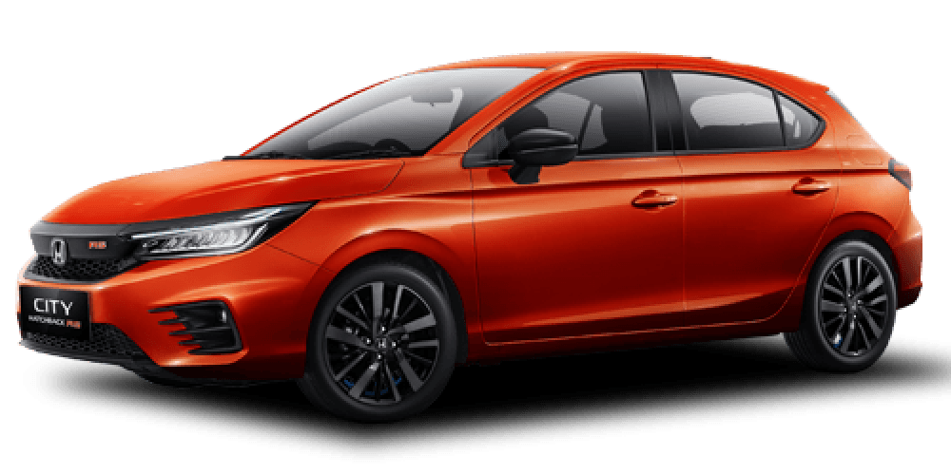
206. HONDA CITY 1.5 (Hatchback)

Slide 7
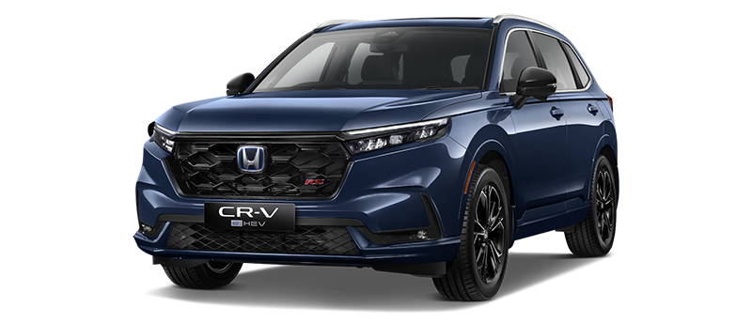
208. HONDA CR-V BENSIN

Slide 8
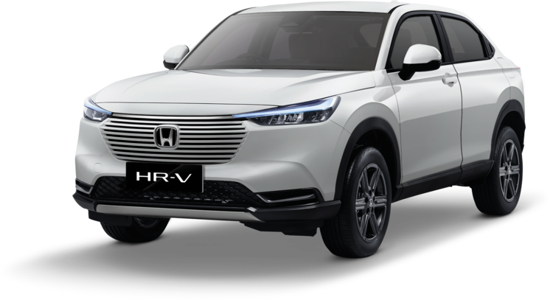
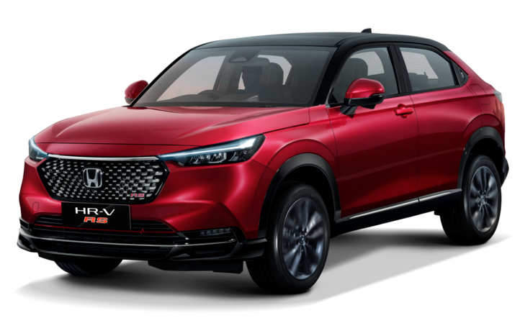
212. HONDA HR-V
212. HONDA HR-V RS

Slide 9


216. HONDA WR-V
216. HONDA WR-V RS

Slide 10
217. HONDA CR-V HYBRID

Slide 11
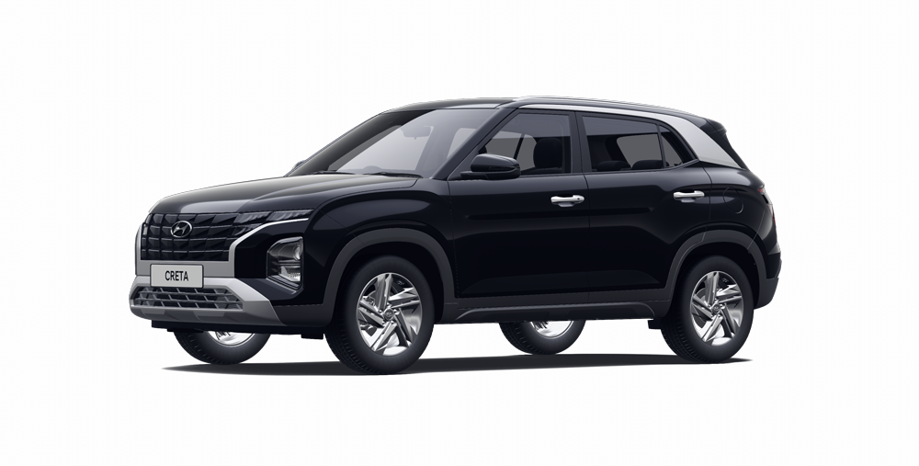
302. HYUNDAI CRETA

Slide 12
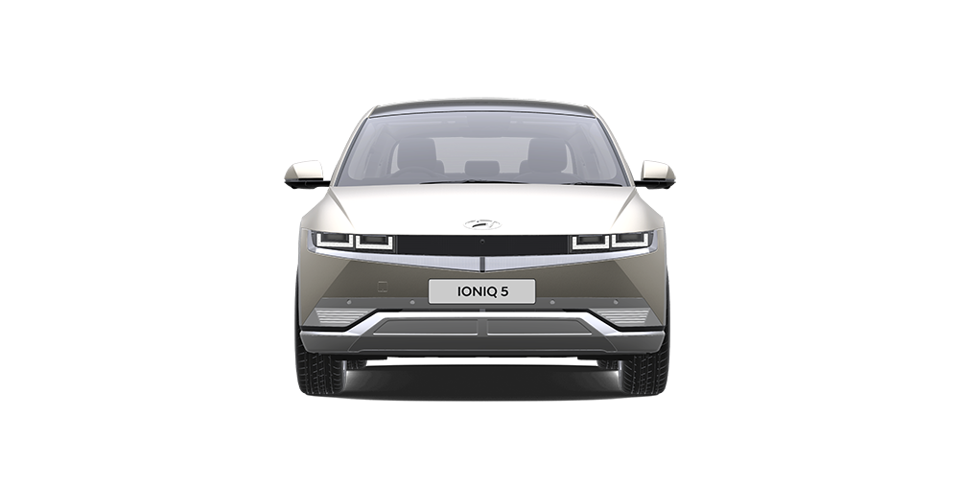
305. HYUNDAI IONIQ 5

Slide 13

307. HYUNDAI PALISADE

Slide 14
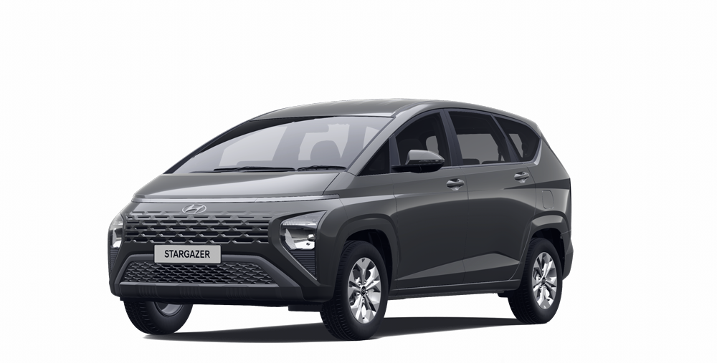
310. HYUNDAI STARGAZER

Slide 15
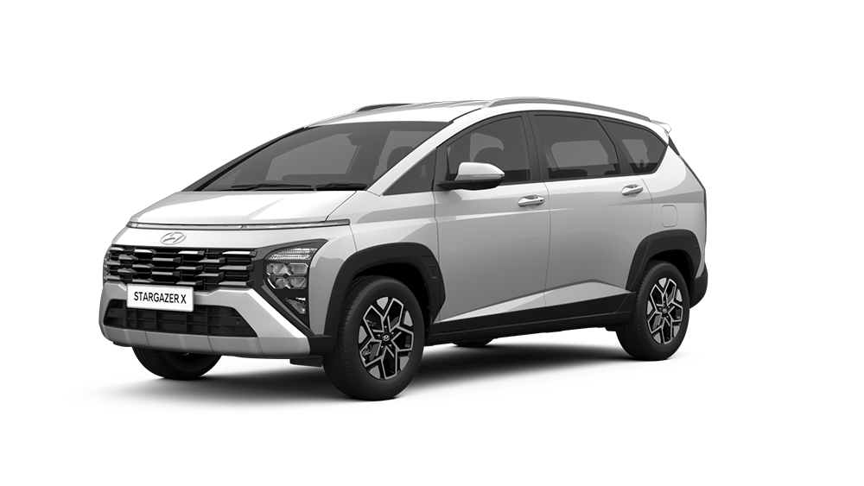
313. HYUNDAI STARGAZER X

Slide 16
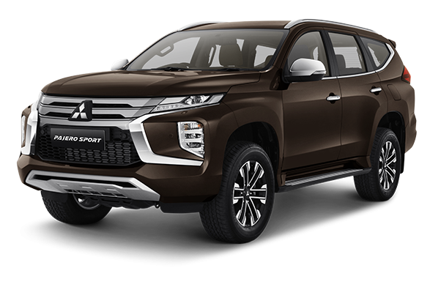
610. MITSUBISHI PAJERO SPORT

Slide 17
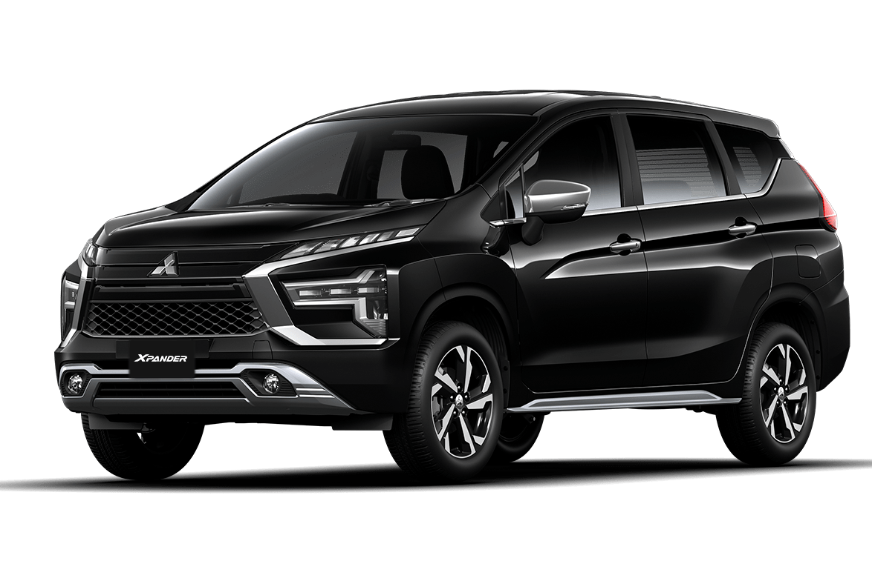
612. MITSUBISHI XPANDER

Slide 18
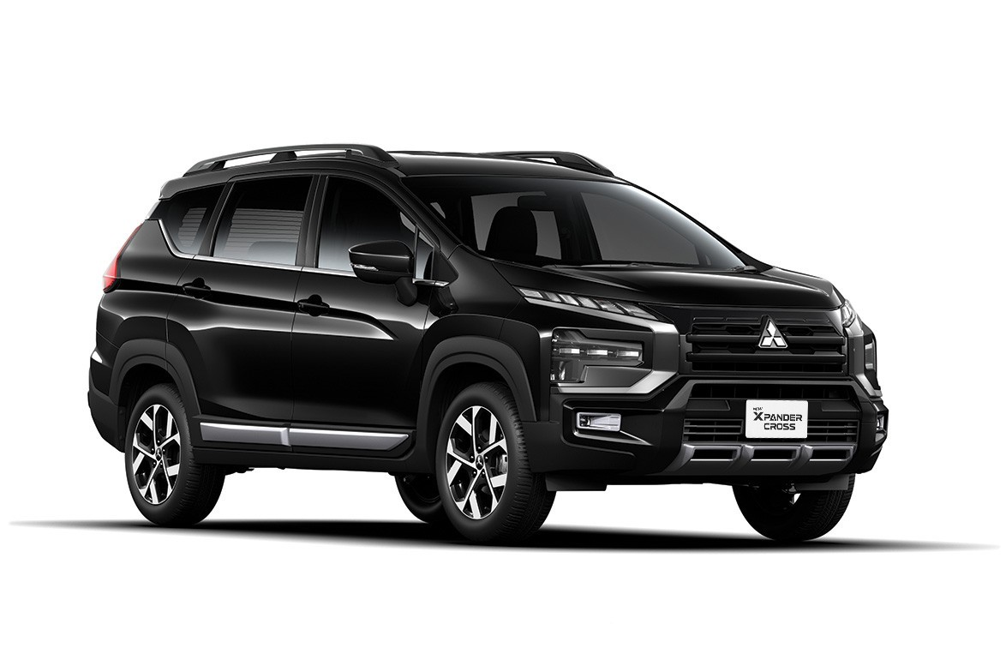
613. MITSUBISHI XPANDER CROSS

Slide 19
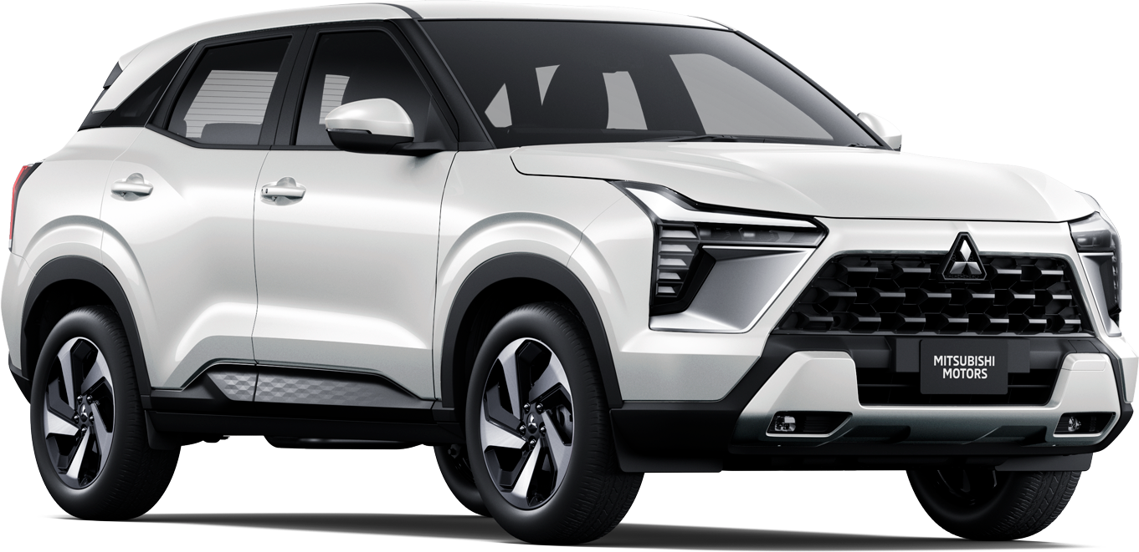
614. MITSUBISHI XFORCE

Slide 20
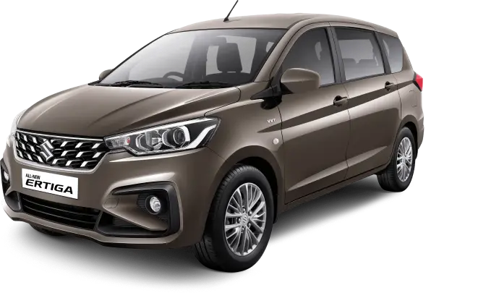
806. SUZUKI ERTIGA BENSIN

Slide 21

807. SUZUKI ERTIGA HYBRID

Slide 22
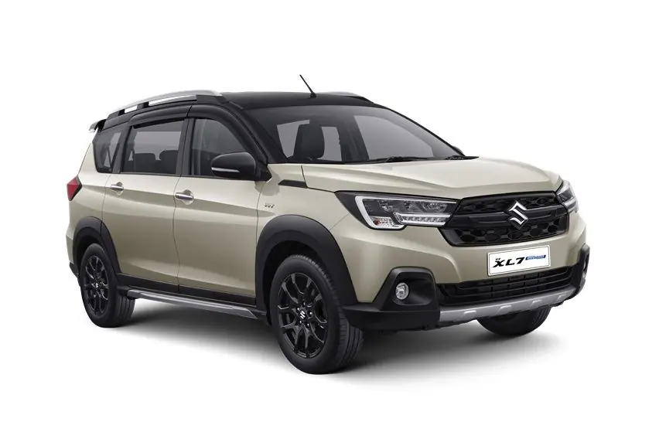
8152. SUZUKI XL7 HYBRID

Slide 23
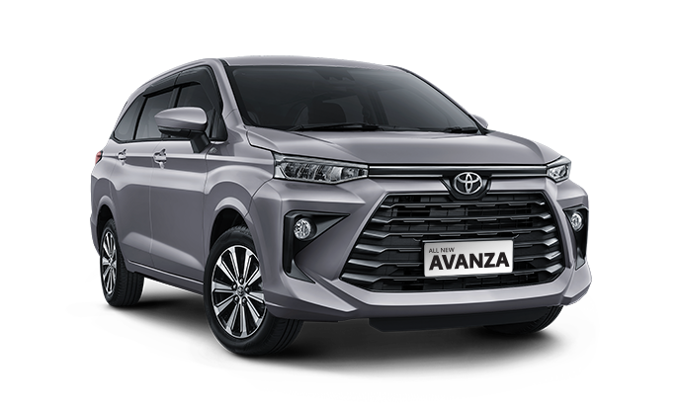
904. TOYOTA AVANZA

Slide 24
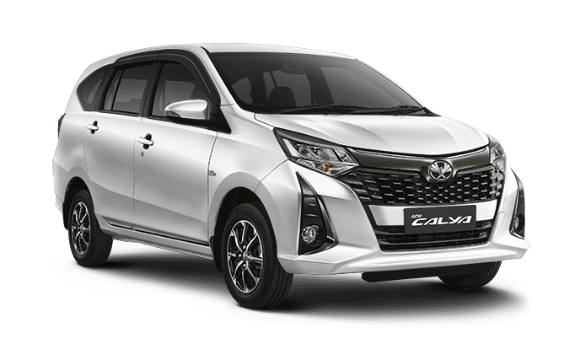
905. TOYOTA CALYA

Slide 25
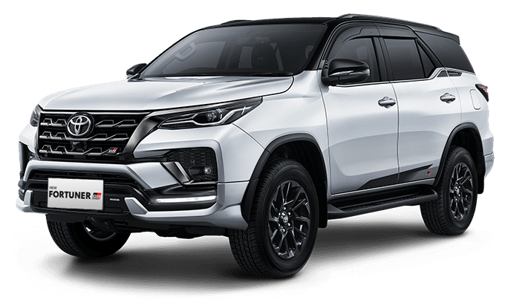
9151. TOYOTA FORTUNER BENSIN

Slide 26
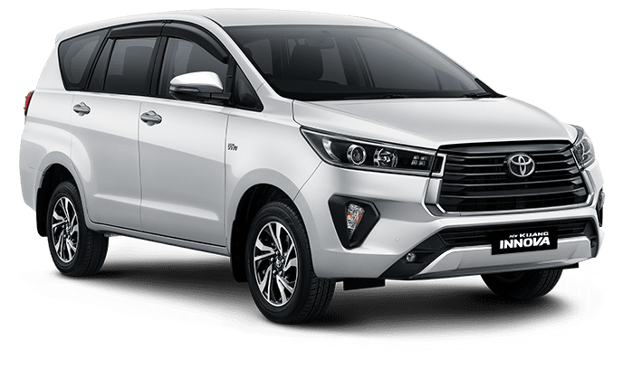
9171. TOYOTA INNOVA BENSIN

Slide 27
9172. TOYOTA INNOVA DIESEL

Slide 28

918. TOYOTA INNOVA ZENIX BENSIN

Slide 29
919. TOYOTA INNOVA ZENIX HYBRID

Slide 30

922. TOYOTA RAIZE

Slide 31
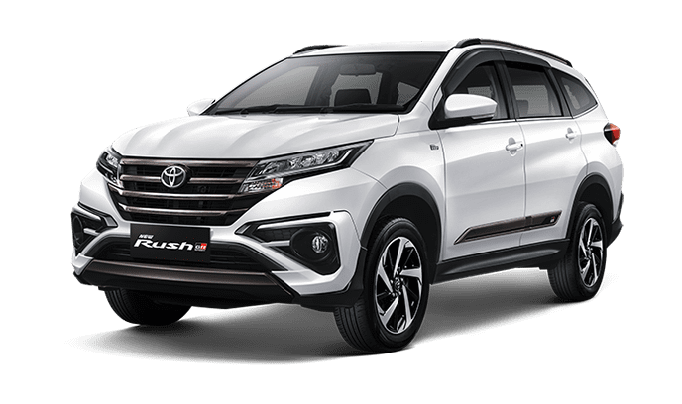
923. TOYOTA RUSH

Slide 32
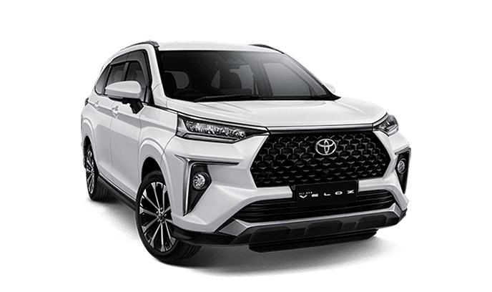
926. TOYOTA VELOZ

Slide 33
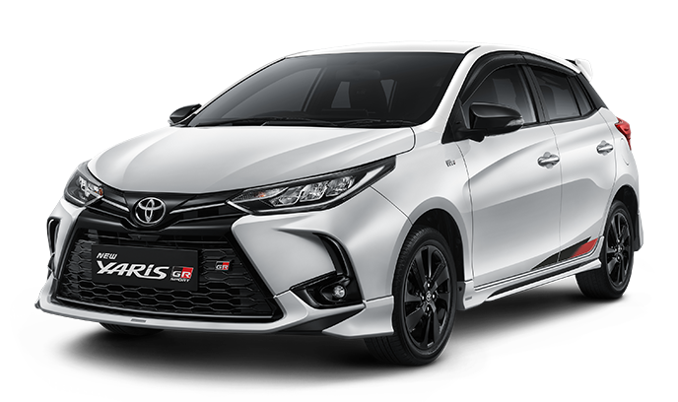
928. TOYOTA YARIS

Slide 34
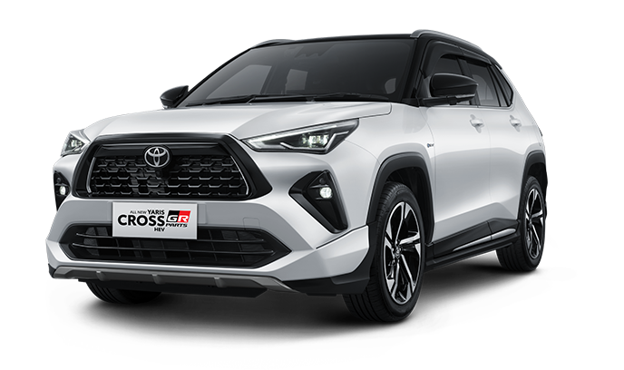
929. TOYOTA YARIS CROSS BENSIN

Slide 35
930. TOYOTA YARIS CROSS HYBRID

Slide 36
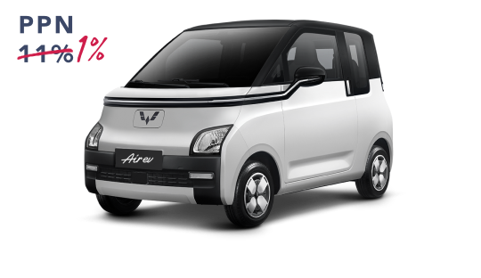
1001. WULING AIR EV

Slide 37
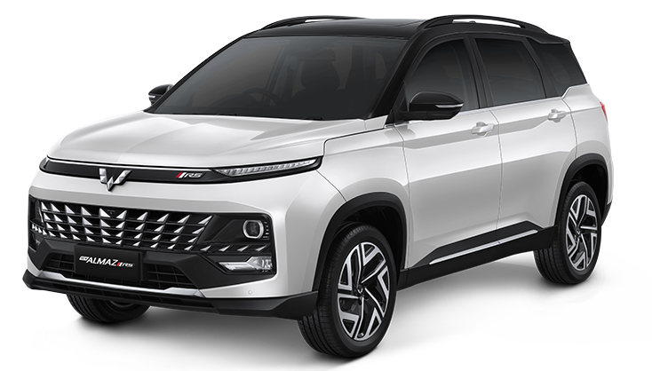
1001. WULING ALMAZ BENSIN

Slide 38
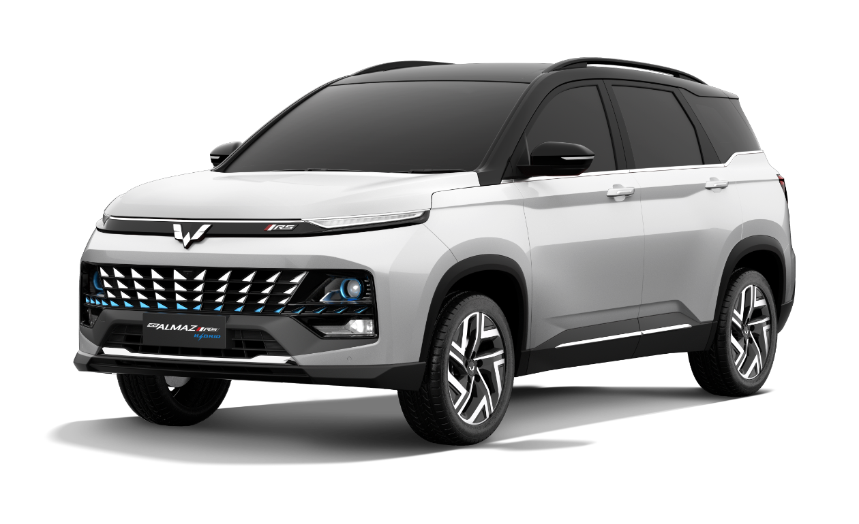
1003. WULING ALMAZ HYBRID

Slide 39
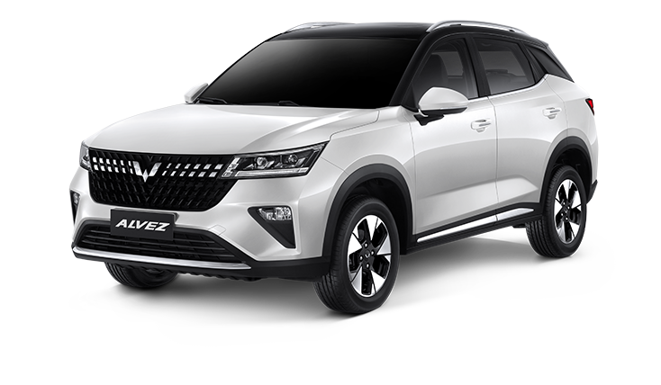
1006. WULING ALVEZ

Slide 40
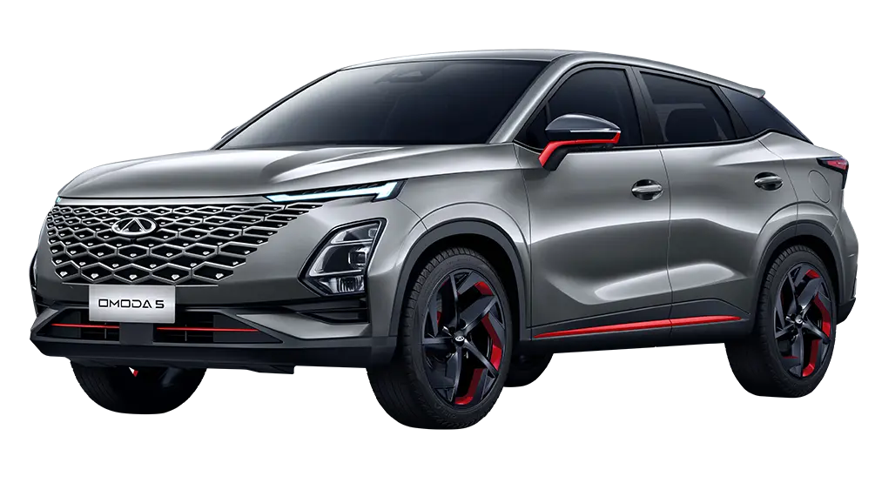
1101. CHERY OMODA 5

Slide 41
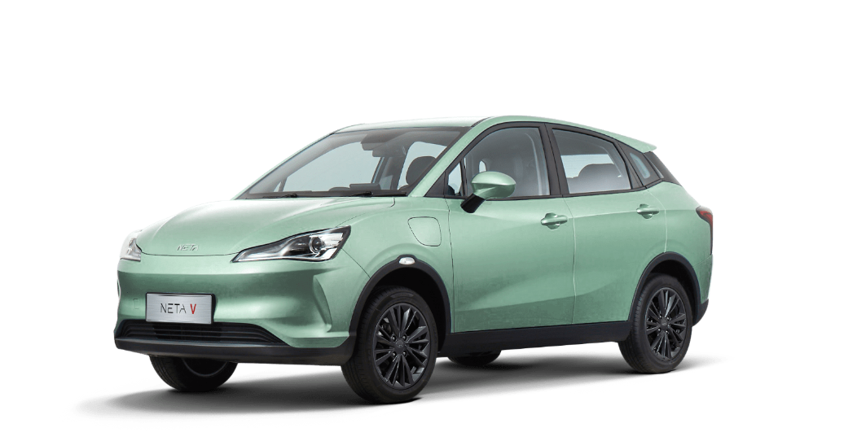
1201. NETA V

